Slide 1
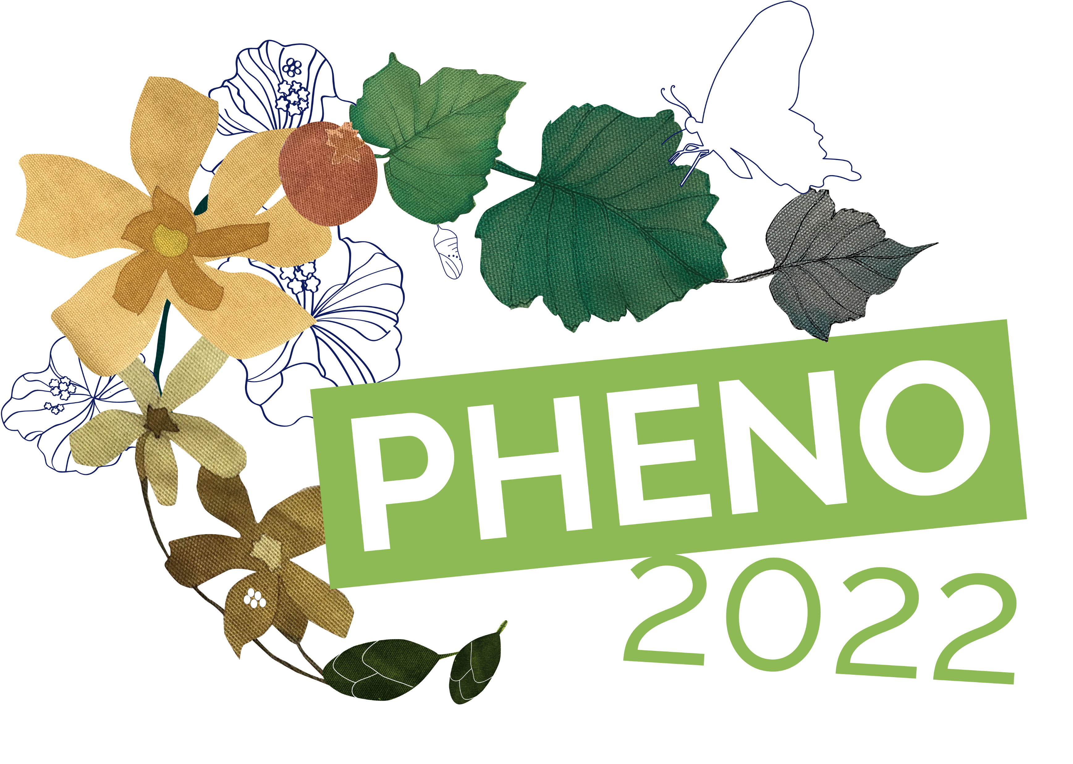
PHENOLOGY IN AEROBIOLOGY NETWORK
THIBAUDON Michel,
Réseau National de Surveillance Aérobiologique
(RNSA - France)

Slide 2
Pollen transport
Anemogamy: by the wind
Hydrophily: by water
Entomogamy: by insects

Slide 3
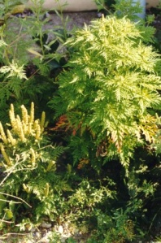
Aerobiology: a multidisciplinary approach
Dispersion
&
Transportation
Emission
Deposition
Atchoum !
Source
Impact
Receiver

Slide 4
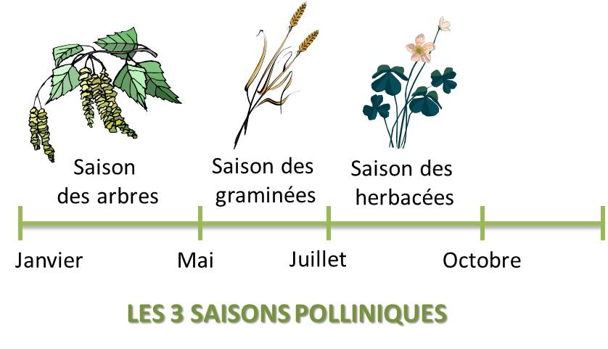
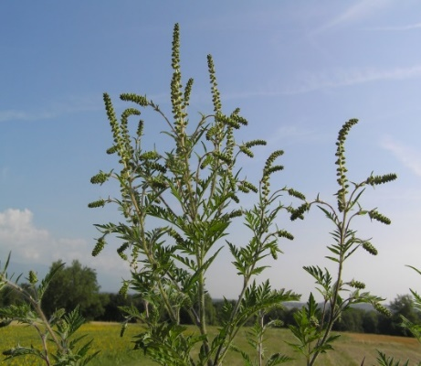
Trees pollen Grasses pollen Weeds pollen (ragweed…)

Slide 5
Pollen allergy
Conjunctivitis
Asthma
I weep for
Rhinitis 90%
Urticaria and eczema 20%
Its prick
Conjunctivis 75%
I cough
I am itchy
Tracheitis, asthma 50%

Slide 6
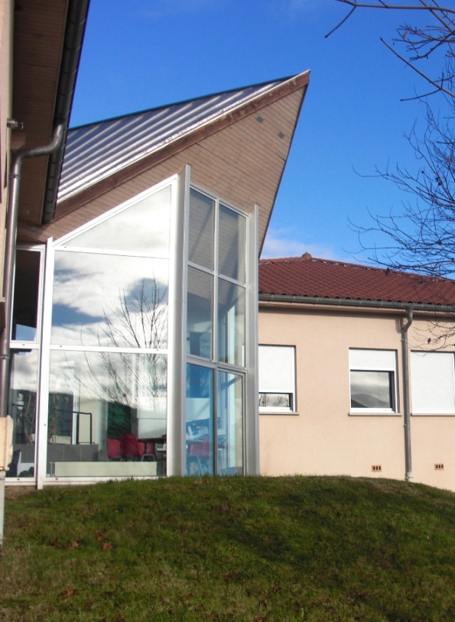
Coordination center
Pollen data
Phenological data
Clinical data
RNSA - Brussieu

Slide 7
Trap network
In France, there are more than 70 traps
Black points are for seasonal traps
Red points are for ragweed traps

Slide 8
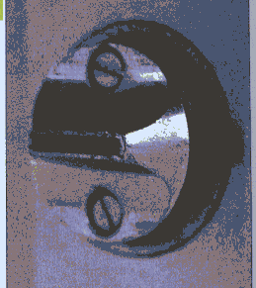
Pollen exposure measurement : pollen trap
Current standard method in Europe
Breathing orifice
(10 L air/min)‏
Horizontal
reading
Adhesive band on the drum
1st day
2nd day
etc...
1h = 2mm
Measurements were made with Hirst-type pollen traps.

Slide 9
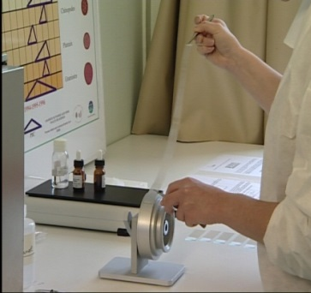
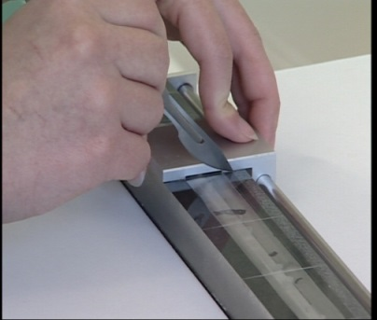
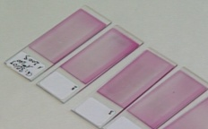
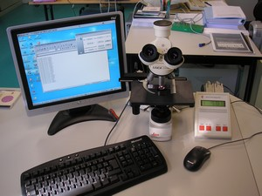
Analysis
Collection of the
drum band
Dividing the band
into daily sections
1 slide by day
Daily concentration (pollen.day/m3)
Counting with a
vocal recognition system
Pollen count
+ spores count

Slide 10
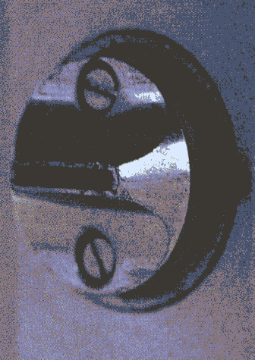
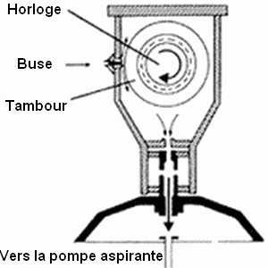
Metrology pollens and spores
Clock
Air inlet
Drum
To the suction pump

Slide 11
Phenological network
12 botanical gardens

Slide 12
Phenological report
Botanists fill in every week a questionnaire to give us the state of flowering plant.

Slide 13
Bulletin phénologique
Floraison aulne
Floraison bouleau
Floraison graminées

Slide 14
Clinical network
the network includes about 100 referring doctors

Slide 15
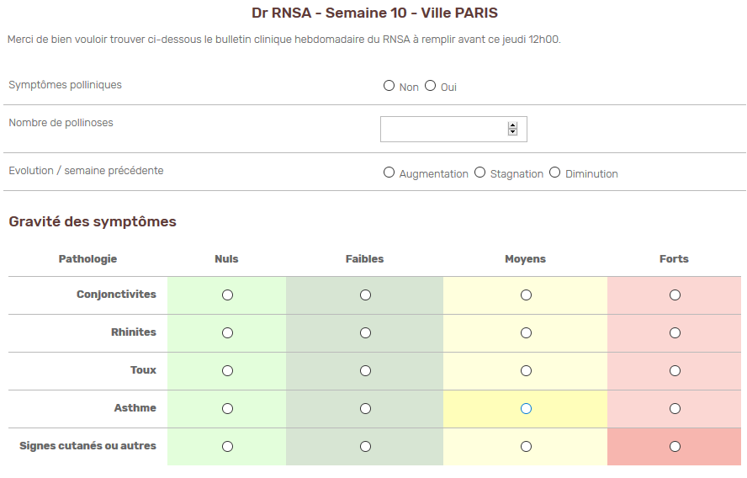
Clinical report
Each week, doctors inform us about clinical symptoms and their severity.

Slide 16
Pollen and clinical index Lyon
Tree period
Grasses period
Ragweed period

Slide 17
Evolution clinical index France 2019-2020-2021
Clinical index
N° week

Slide 18
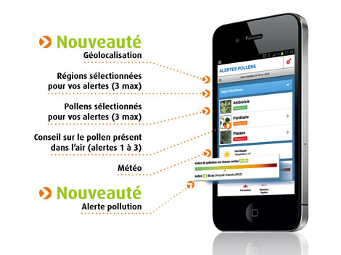
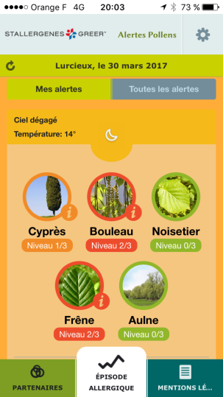
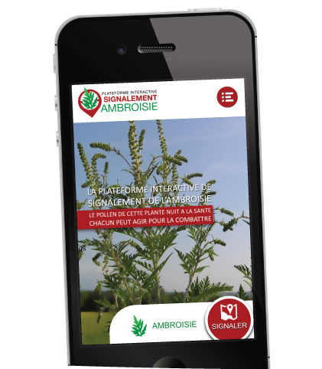
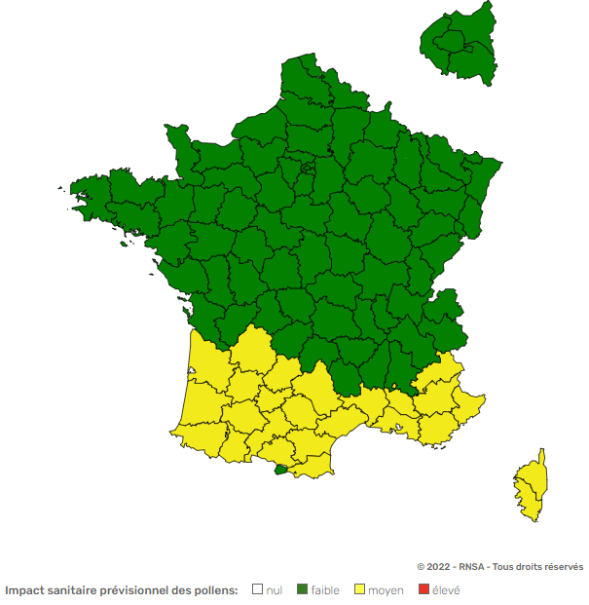
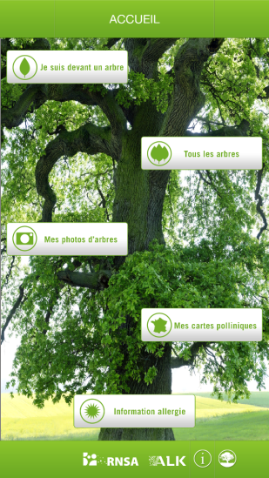
Information in France – website, Apps…
www.pollens.fr

Slide 19
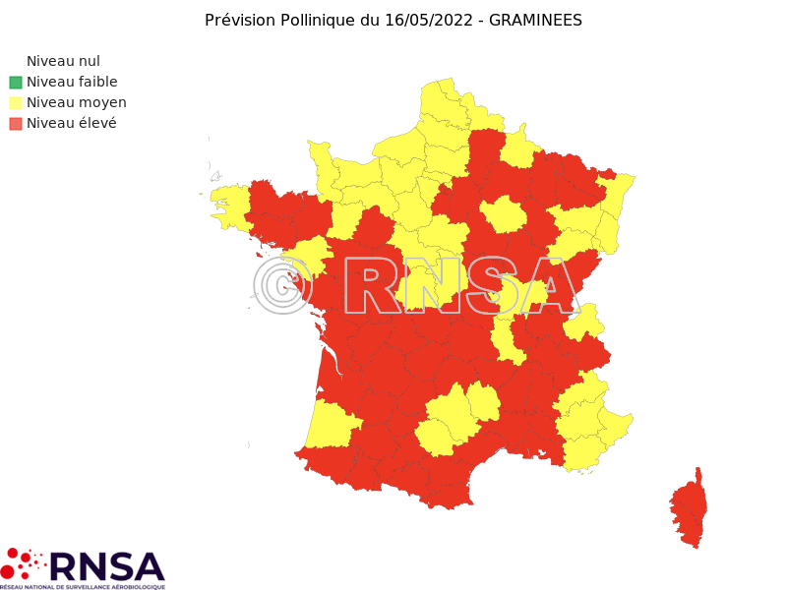
Information in France – Social networks
* Twitter: https://twitter.com/rnsa_pollen
* LinkedIn: https://www.linkedin.com/company/r%C3%A9seau-national-de-surveillance-a%C3%A9robiologique/?viewAsMember=true
* Facebook: https://www.facebook.com/RNSApollens
* Instagram: https://www.instagram.com/rnsapollens/

Slide 20
Information : Mail alert

Slide 21
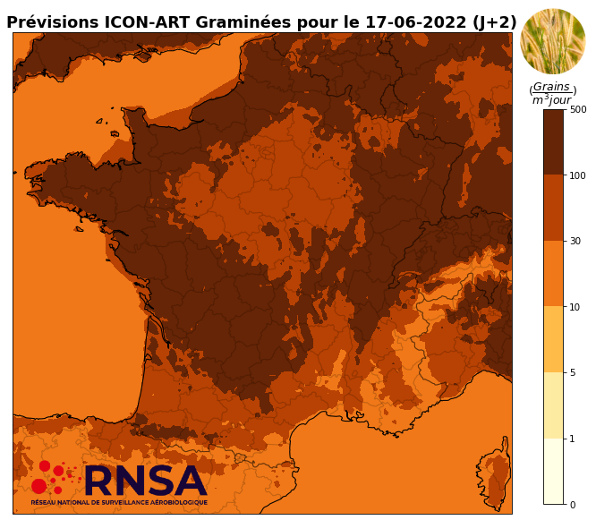
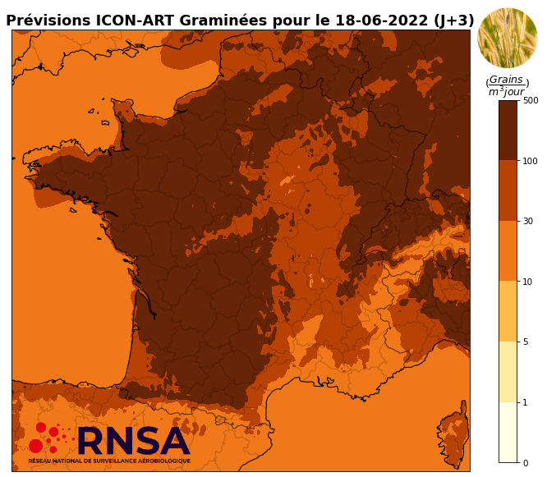
Modeling (exemple : grasses pollen)
https://www.pollens.fr/en/cartes-de-modelisations
21

Slide 22
Results’leaflets
M. THIBAUDON – 71/82

Slide 23
Who to inform?
The clinicians/doctors
Better diagnosis
Better treatment
Better prevention
The patients (alert system)
Help for diagnosis
Better treatment
Health authorities

Slide 24
Difference between allergy potency and allergy risk
The allergy potency is specific to a pollen grain whatever the location while the allergy risk is a measure of health impact and depends on several factors such as the amount of pollen, the weather, the phenology, the symptoms observed by doctors…

Slide 25
Allergy potency of plants
The allergy potency of a plant species is the ability of its pollen to cause an allergy to a significant part of the population
The allergy potency can be:
Low or negligible : This means that a very large amount of pollen is needed to trigger an allergy and this applies only to the most sensitive people
Moderate : These species may be present locally to bring diversity into plantations, but they should not represent the majority of planted species
High : A few number of pollen is enough to cause an allergic reaction

Slide 26
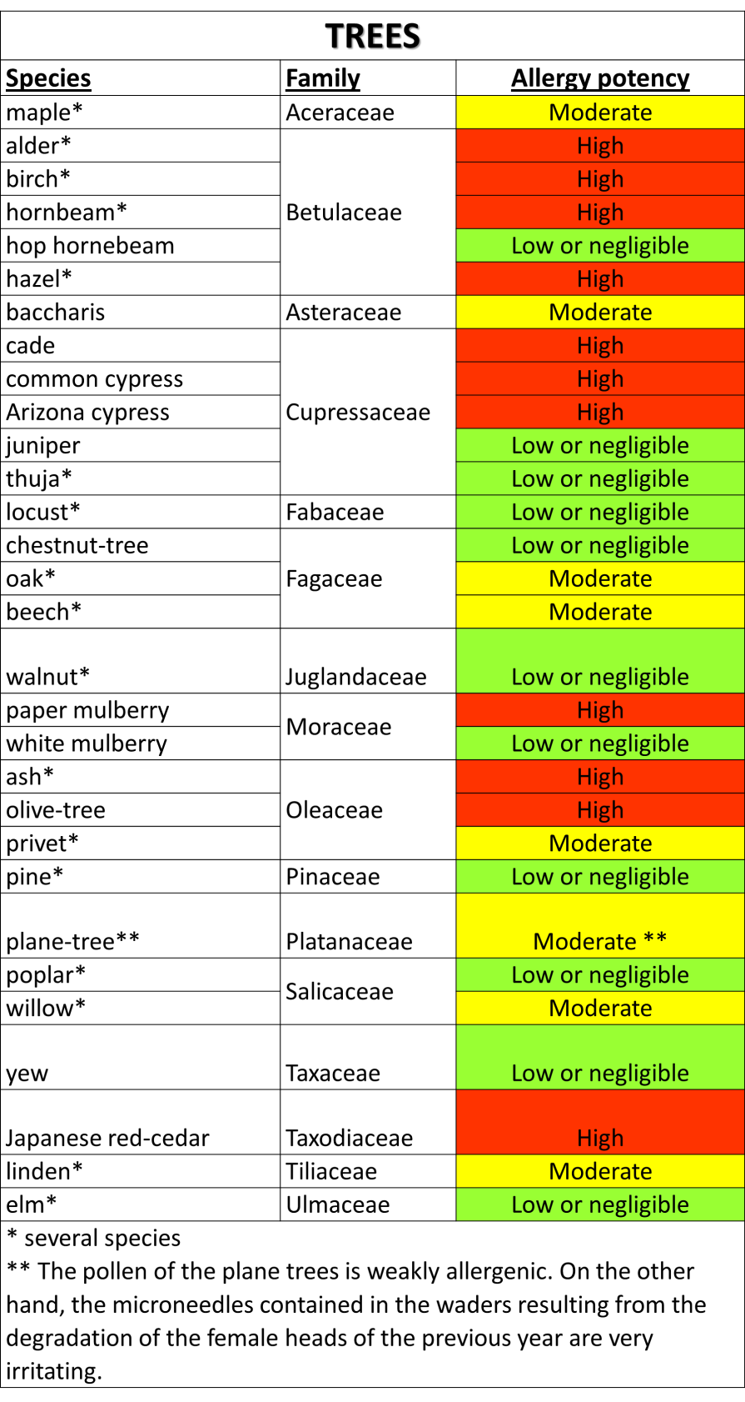
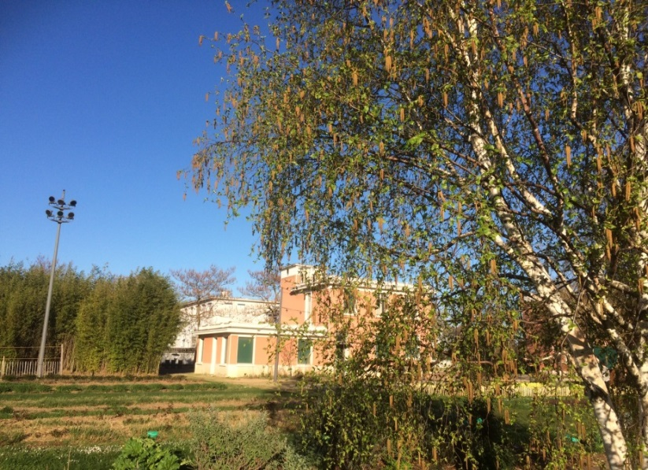
Allergy potency of trees
Birch
LIFE13 ENV/IT/001107

Slide 27
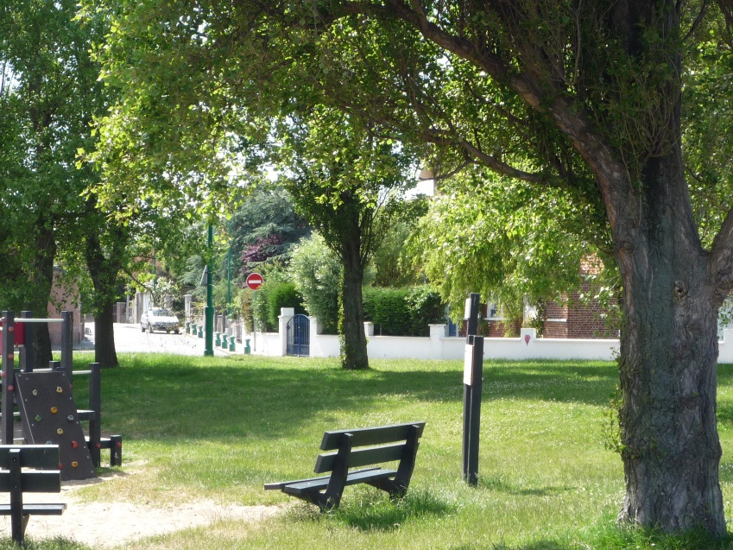
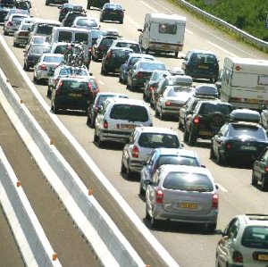
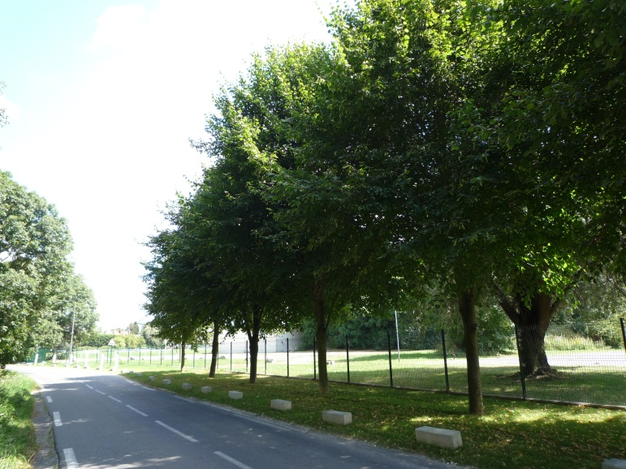
Urban Vegetation & Air Quality
Absorption of pollutants
Absorption of particulate pollutants
P
P
P
Effect on well-being
Fight against stress

Slide 28
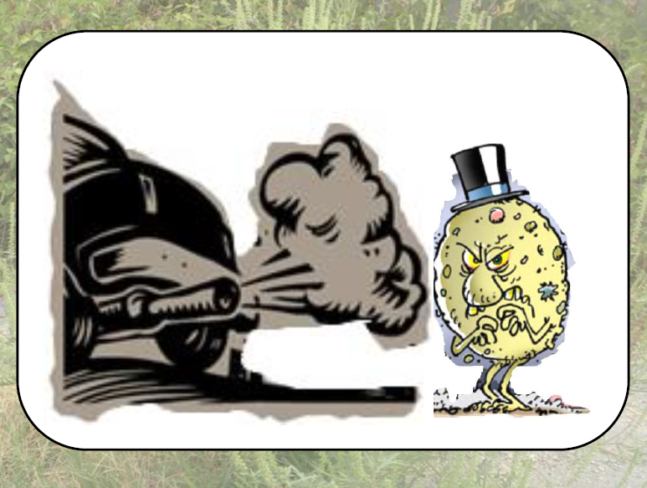
Pollution and pollen
Pollutants (NO₂, O₃, PM₁₀ et PM_{2.5}) act:
By weakening the respiratory system
On the aeroallergens contained in the pollen grains
On the structure of the pollen grains
On allergenicity of
the pollen grains
Health
Pollution
Pollen
Notes:
Dès 1876 des travaux de Charles Backley montrent que cette affection, appelée l’allergie, ne touche que les pays industrialisés. L’apparition de la rhinite dans différentes régions d’Europe et celle de la pollution chimique massive de l’atmosphère s’avèrent concomitantes: en effet la Grande-Bretagne fut la première à réaliser sa révolution industrielle, suivie par l’Allemagne et la France. L’allergie est en progression constante, et sa prévalence s’accroît en parallèle avec l'augmentation de la pollution. Depuis la fin du XIXe siècle les pollinoses semblent régulièrement progresser, au même rythme que la pollution globale de l'air. Les polluants gazeux et particulaires sont considérés comme facteurs aggravants de la réaction allergique. Dans les pays occidentaux, la pollution atmosphérique est liée, d’une part, à des composés gazeux comme l’ozone (O3), les oxydes d’azote (NO, NO2), les hydrocarbures ainsi que le dioxyde de soufre (SO2) et, d’autre part, à des polluants particulaires tels que les PM10 et PM2.5. Ces polluants agissent, soit d’une manière directe, en fragilisant l’appareil respiratoire, soit sur les aéroallergènes tels que ceux contenus dans les grains de pollen, en jouant sur la structure même du pollen ou, encore, en modifiant leur allergénicité [48,49].
Pour résumer, les effets directs de la pollution sur les grains de pollen sont constatés à plusieurs niveaux :
altération de la fonction reproductive du pollen,
changements physico-chimiques de la surface du grain et fragilisation de la membrane cytoplasmique,
modification du potentiel allergisant,
augmentation de la production de ROS et donc par extension, aggravation des effets pro-inflammatoires [48].

Slide 29
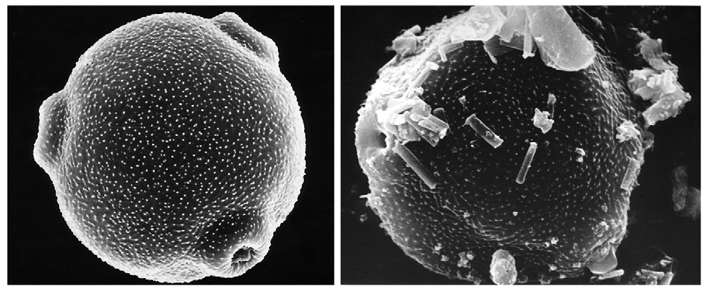
Pollution and pollen
Birch pollen in the countryside Birch pollen in town
H. Behrendt & W.M. Becker, 2001 : Curr Opin Immunol 13, 709-715

Slide 30
Conclusion
Thanks to phenological data in particular, information on the allergy risk linked to exposure to pollen is predictive and helps allergy sufferers.
In addition, at the request of the Ministries of Health and Ecology,the RNSA published, in 2008, an electronic guide "vegetation in the city" which aims to inform public or private decision-makers and landscapers, on the need to take into account the health component in the choice and maintenance of plant species set up in urban or peri-urban spaces. https://www.vegetation-en-ville.org/

Slide 31
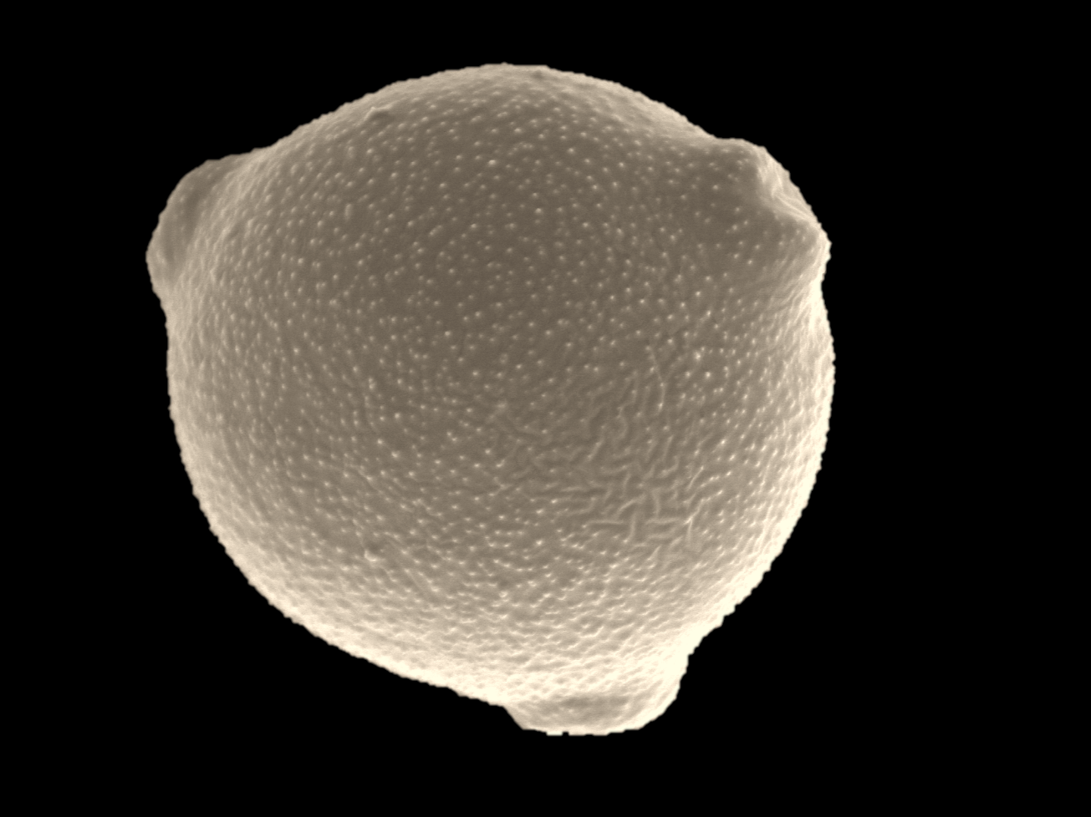
Thank you for your attention
www.pollens.fr
https://www.vegetation-en-ville.org/

